Slide 1
CS 4843 Cloud Computing Machine Learning with Spark
Palden Lama, PhD
Department of Computer Science
University of Texas at San Antonio

Slide 2
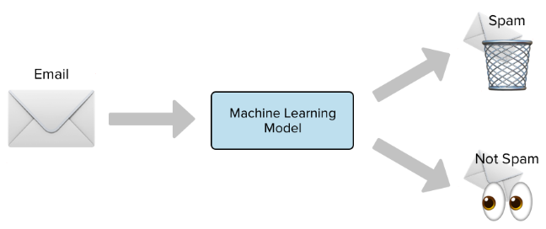
Machine Learning
The science of getting computers to accomplish a task without being explicitly programmed about how to do the task. It is a key technique used in the field of Artificial Intelligence (AI).
Example applications:
Spam email detection, face recognition, voice recognition, detection of credit card frauds, self-driving cars, autonomous drones, etc.
Machine Learning algorithms learn from data to make predictions and decisions.

Slide 3
Machine Learning Types: Supervised
Supervised Learning : learn through examples
Classification: determining what category something belongs to, after seeing a number of examples of things belonging to several categories.
e.g spam detection, face detection etc.
Regression: learn a function that describes the relationship between inputs and outputs, and predicting how the output change with change in inputs.
e.g predict housing price, stock price, etc.

Slide 4
Machine Learning Types: Unsupervised
Unsupervised Learning: learn without examples
Finding patterns in data without explicit labels in the training examples
Often used in data mining
Unsupervised classification of data
Cyber security: Detecting suspicious activities (potential cyber attacks) recorded in log files.
Marketing: Help marketers discover distinct groups in their customer bases, and then use this knowledge to develop targeted marketing programs
Banking: Identifying fraudulent credit card transactions, risky loan applications, etc.
Many more..

Slide 5
Spark and Machine Learning
Why Spark for Machine Learning ?
Parallel data access and computation for faster learning
Iterative re-use of data in memory
Spark Machine Learning library (included with Spark installation)
MLlib : uses RDDs
ML : used Dataframes
Pre-requisites
Install numpy on every node in the Spark cluster
sudo apt-get install python-numpy

Slide 6
Example: K-means clustering (Unsupervised machine learning)
Notes:
To Skip to the next section, go to slide 51

Slide 7
K-Means Clustering
Unsupervised Machine Learning Algorithm
Groups objects (data points) based on similarity of attributes/features into K groups.
The value of K is specified by the user
Use Cases:
Online advertisement targeting (marketing), detecting suspicious credit card transactions, etc.

Slide 8
Basic Idea
Given k, the k-means algorithm consists of four steps:
Select initial centroids (cluster centers) at random.
Assign each data point to the cluster with the nearest centroid.
Compute new centroids as the mean of the data points assigned to each cluster.
Repeat previous 2 steps until convergence is reached.

Slide 9
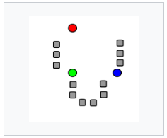
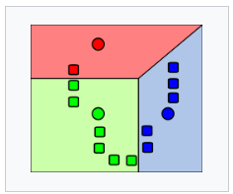
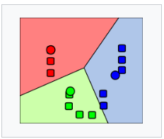
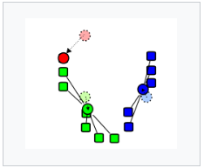
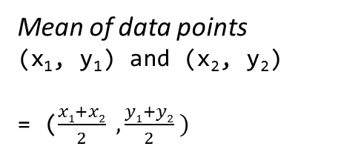
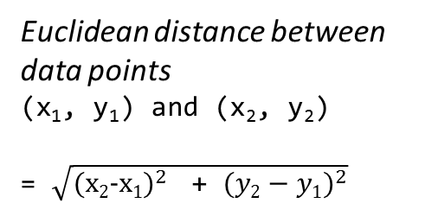
Example: K-means (k=3)
Euclidean distance between data points
(x₁, y₁) and (x₂, y₂)
= $\sqrt{{\text{(}\text{x}\text{2}\text{−}\text{x}\text{1}\text{)}}^{2} \text{ + }{(y2−y1)}^{2}}$
Mean of data points
(x₁, y₁) and (x₂, y₂)
= ($\frac{x1+x2}{2} , \frac{y1+y2}{2} )$

Slide 10
Example: K-means with Spark
Input Data
(kmeans_data.txt)
-------------------------
0.0 0.0 0.0
0.1 0.1 0.1
0.2 0.2 0.2
9.0 9.0 9.0
9.1 9.1 9.1
9.2 9.2 9.2
Parse the data into a suitable format
Kmeans model with K=2
---------------------------------------
1) Shows Cluster Centers
[array([ 0.1, 0.1, 0.1]),
array([ 9.1, 9.1, 9.1])]
2) It can predict which cluster will a new data point belong to.
[array([ 0., 0., 0.]), array([ 0.1, 0.1, 0.1]), array([ 0.2, 0.2, 0.2]), array([ 9., 9., 9.]), array([ 9.1, 9.1, 9.1]), array([ 9.2, 9.2, 9.2])]
Train the model

Slide 11
K-means in Spark
from pyspark.mllib.clustering import KMeans
from pyspark import SparkContext
import numpy as np
sc = SparkContext(appName="PythonKMeans")
sc.setLogLevel("ERROR")
# Load and parse the data (convert input string to an array of floating points)
data = sc.textFile("file:///usr/local/spark-1.6.1-bin-hadoop1/data/mllib/kmeans_data.txt")
parsedData = data.map(lambda line: np.array([float(x) for x in line.split(' ')]))
# Build the model (cluster the data)
model = KMeans.train(parsedData, 2, maxIterations=10, initializationMode="random")
# Cluster centers
print "cluster centers: ", model.clusterCenters
print "number of clusters=", model.k
# Assign clusters for new data
print "[2,3,4] belongs to cluster : ", model.predict(np.array([2,3,4]))
print "[8,5,4] belongs to cluster : ", model.predict(np.array([8,5,4]))

Slide 12
Running the K-means program
cd /usr/local/spark-1.6.1-bin-hadoop1
bin/spark-submit --master spark://IPADDRESS:7077 /home/cc/kmeans.py
Use private ip address of master VM

Slide 13
Example: Logistic Regression (Supervised machine learning)
Notes:
To Skip to the next section, go to slide 51

Slide 14
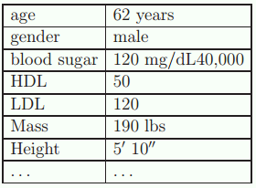
Logistic Regression
Supervised machine learning algorithm that predicts binary response.
simple and widely used machine learning technique
popular in most medical fields, and social sciences
Is a patient likely to have diabetes ?
YES/NO
(Binary response)
Logistic
Regression
Model
the probability that a patient has diabetes.

Slide 15
Applications of Logistic Regression
Medical field
predict the risk of developing a given disease (e.g. diabetes, coronary heart disease) , based on observed characteristics of the patient (age, gender, body mass index, results of various blood tests, etc.)
Others
predict the likelihood of a homeowner defaulting on a mortgage
predict whether a customer is likely to purchase a product or halt a subscription
predict whether a voter will vote for Democratic or Republican party

Slide 16
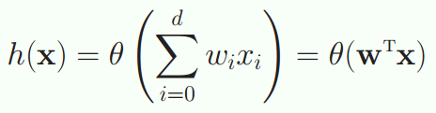
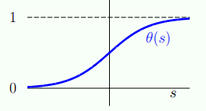

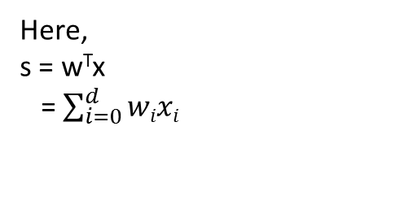
Logistic Regression (cont’d)
Probability that a dependent variable (y) is true or false is given by
y =
x : input features (known)
w: weights applied on each feature
(needs to be learned)
Here,
s = w^{T}x
= $\sum_{i=0}^{d}{wixi}$
Sigmoid function θ(s) ranges from 0 to 1.
the shape of the function is determined by w

Slide 17

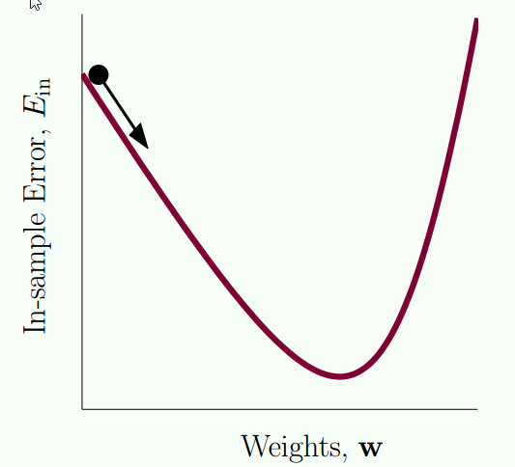
Logistic Regression (cont’d)
Initialize w randomly
Iteratively update w to minimize the logistic loss function, where the loss function captures the penalty for making incorrect predictions.
One solution: Gradient Descent technique guides
how to update w in each iteration
y =

Slide 18
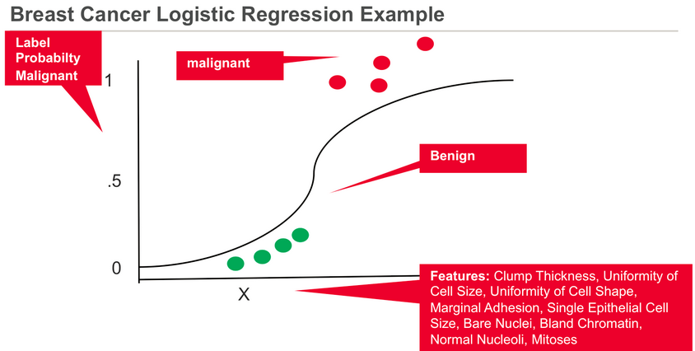

Slide 19
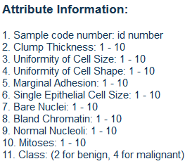
Logistic Regression Case Study
Predicting breast cancer based on Wisconsin Diagnostic breast cancer data set.
https://archive.ics.uci.edu/ml/datasets/Breast+Cancer+Wisconsin+(Original)
342245,1,1,3,1,2,1,1,1,1,2
1016634,2,3,1,1,2,1,2,1,1,2
1116192,1,1,1,1,2,1,2,1,1,2
535331,3,1,1,1,3,1,2,1,1,2
1221863,10,10,10,10,7,10,7,10,4,4
1294562,10,8,10,1,3,10,5,1,1,4
1320077,1,1,1,1,1,1,2,1,1,2
1324572,5,1,1,1,2,1,2,2,1,2
1285531,1,1,1,1,2,1,3,1,1,2
1131294,1,1,2,1,2,2,4,2,1,2
95719,6,10,10,10,8,10,7,10,7,4
1206089,2,1,1,1,1,1,3,1,1,2

Slide 20
Breast Cancer Dataset
Login to you master VM and download the Wisconsin breast cancer data set.
wget https://archive.ics.uci.edu/ml/machine-learning-databases/breast-cancer-wisconsin/breast-cancer-wisconsin.data
Upload the dataset to HDFS
$HADOOP_PREFIX/bin/hadoop fs -put /home/cc/breast-cancer-wisconsin.data /wisconsin

Slide 21
Logistic Regression with Spark
Steps involved
Create an RDD of training data set (by reading from HDFS or local filesystem). Each line of data from the data set will become one element of the RDD.
Filter out non-numeric data from the dataset.
Transform the RDD so that each data element is reformatted as an object of a special class called LabeledPoint.
Call the train( ) method of the LogisticRegression class, while passing the LabeledPoint dataset as input parameter.
Call the predict( ) method of the LogisticRegression class, to make predictions for any new data sample.

Slide 22
Logistic Regression with Spark
from pyspark.mllib.classification import LogisticRegressionWithLBFGS
from pyspark.mllib.regression import LabeledPoint
from pyspark import SparkContext
import numpy as np
import re
sc = SparkContext(appName="LogisticRegression")
# Load and parse the data
data = sc.textFile("hdfs://ipaddress:54310/wisconsin")
# filter out non-numeric data
newdata = data.filter(lambda line: not re.search(r"[^0-9,]",line))
def parsePoint(line):
values = [int(x) for x in line.split(',')]
label =1 if values[10] == 4 else 0
return LabeledPoint(label, values[1:9])
parsedData = newdata.map(parsePoint)
# Build the model (train the model with parsedDatas)
model = LogisticRegressionWithLBFGS.train(parsedData)
# Evaluating the model on training data
labelsAndPreds = parsedData.map(lambda p: (p.label, model.predict(p.features)))
trainErr = labelsAndPreds.filter(lambda (v, p): v != p).count() /float(parsedData.count())
print("Training Error = " + str(trainErr))

